Slide 1
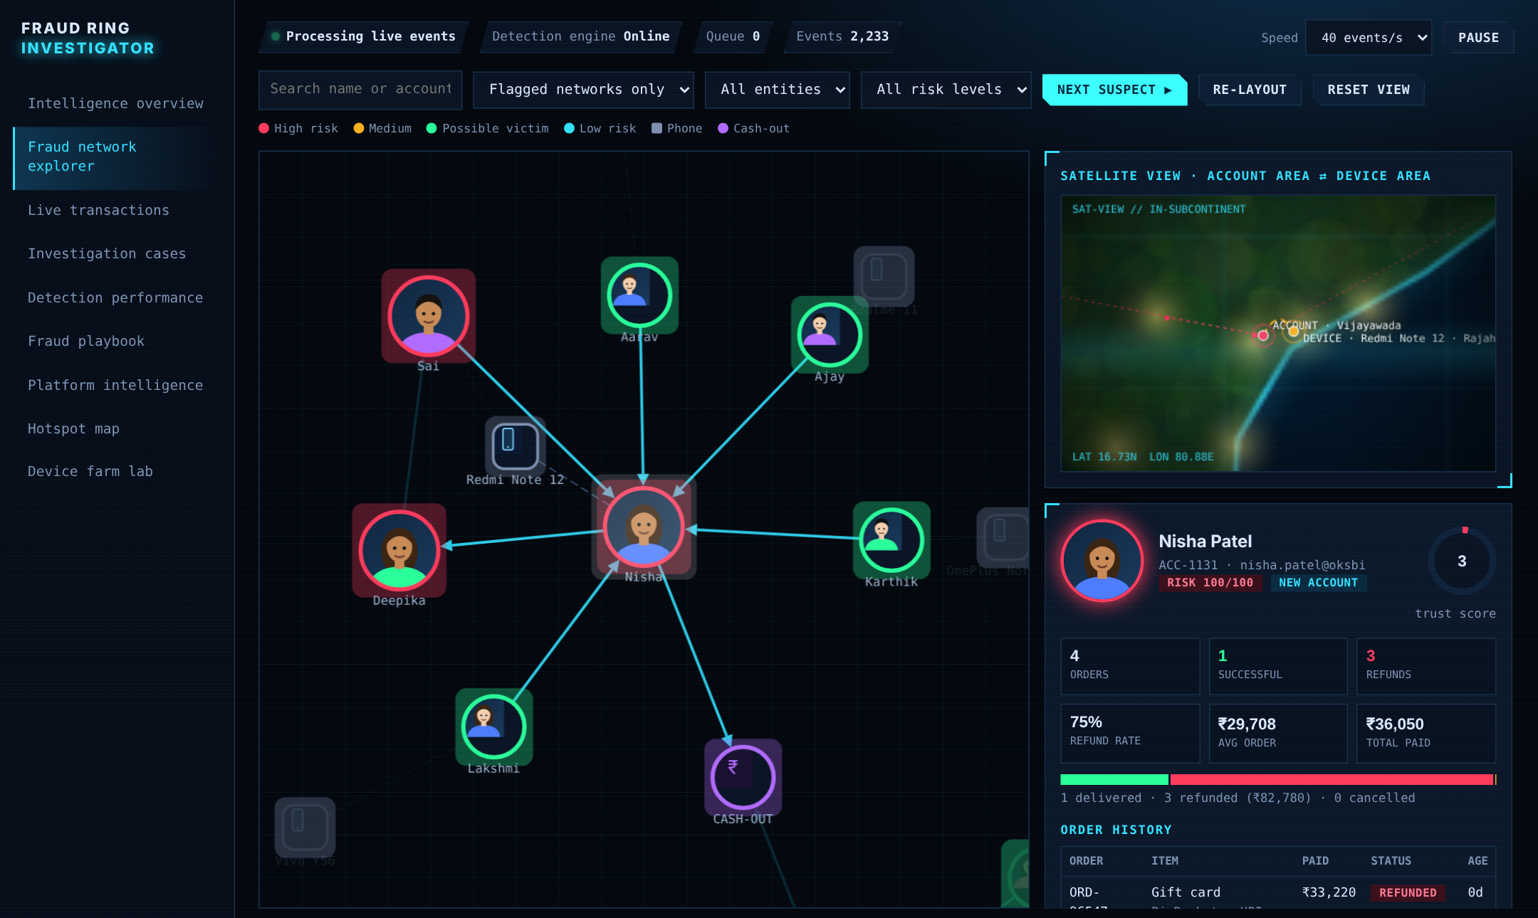
FRAUD DETECTION · JAVA
Fraud Ring Investigator
Catch mule rings and device farms in seconds, not weeks
Zero dependencies · 26 tests · synthetic data
Presented by [YOUR NAME]
Notes:
Open with the one-line pitch: I built a Java engine that spots fraud rings from the shape of the money, tested it against hidden planted fraud, and wrote down every way it failed. Replace [YOUR NAME] before presenting.

Slide 2
Every payment looks normal
≈ 10 s
Mule A
ATM
cash-out
from first payment to the money leaving
Each hop is small, so a rule like “flag above ₹50,000” sees nothing.
5 victims
₹12k–₹48k each
B
C
loop of ₹20,000
Notes:
UPI and IMPS move money in seconds. Mule accounts are lent or opened for criminals. The ring on the left is exactly what the simulator plants: five victims pay one account, three mules pass money in a loop, then an ATM withdrawal. No single transaction is unusual.

Slide 3
Judge the network, not the payment
ONE PAYMENT AT A TIME
THE WHOLE NETWORK
Rule: flag anything above ₹50,000
Shared phone + money loop + fast cash-out
Every hop is under the limit.
VS
Links accounts, phones and time.
Nothing flagged
Risk 100 · HIGH
Notes:
Shift from judging individual transactions to judging connections. That one idea drives every rule in the engine.

Slide 4
Four patterns, one score
+35
Shared device
+25
Rapid cash-out
3+ accounts, 2+ different surnames, one phone
80% of a ₹50,000+ inflow leaves in seconds
+25
Circular transfers
+15
Fan-in
Money returns to its origin in 3–4 hops (DFS)
4+ people pay one account, ₹50,000+, in a minute
Notes:
Points are fixed and visible. Scores add the distinct patterns, capped at 100. Normal behaviour is ignored: families sharing one phone, shoppers paying Flipkart or Myntra, small friendly loops under ₹10,000.

Slide 5
Every score is explained
HIGH
70 and above
CASE-002 risk 100 HIGH
+35 Shared device: 3 unrelated accounts, one phone
+25 Rapid cash-out: INR 144,892 in, INR 140,546
out within seconds
+25 Circular: Lakshmi -> Fatima -> Deepika -> Lakshmi
+15 Fan-in: 4 people paid one account
INR 99,139 within a minute
MEDIUM
40 to 69
LOW
under 40
Alerts on the same account or phone merge into one case, with notes, status and a full audit trail.
Real output from the engine: demo --seed 7
Notes:
This is real output from `demo --seed 7`. A human can defend this score because each point has a stated reason. A score is a lead, not proof.

Slide 6
A live investigation dashboard
1
Click any node
profile, orders, refunds, risk
2
Colour tells the story
red suspect, green victim, square = phone
3
Satellite view
account area vs device area
Notes:
The dashboard is a single HTML file published on GitHub Pages. It runs the same ideas in the browser with a live simulator.

Slide 7
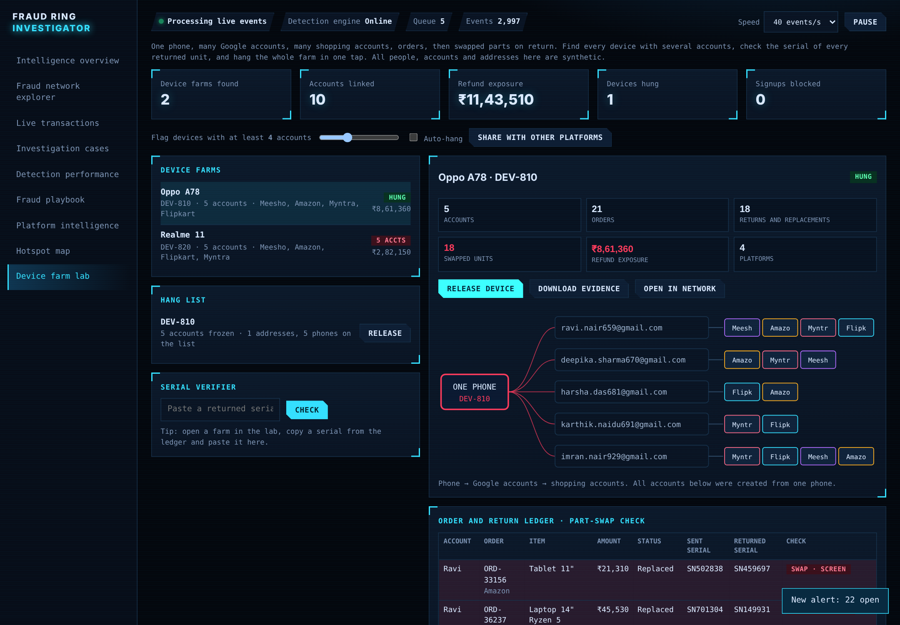
One phone, many accounts
findFarms
phones with many accounts
verifySerial
sent vs returned serial
hang / release
freeze a whole farm at once
gate
ALLOWED · REVIEW · BLOCKED
evidenceReport
ready for trust & safety
Notes:
Return item-swap: a buyer sends back an item with a different serial number and is refunded before anyone checks. The phone linking the accounts is the clue.

Slide 8
Simulate, detect, act
World
Detection engine
CaseBook
Device lab + API
traffic + hidden fraud
4 pattern checks
merge, score, audit
hang, gate, REST
Ground truth
Performance
planted rings, hidden from the detector
recall · precision · false alarms · speed
Notes:
Plain Java, the JDK's built-in HttpServer, no frameworks. One seeded random generator, so every result is reproducible. Evaluation is separate from detection: the detector never reads the labels.

Slide 9
Results: 100 seeds, 2 traffic levels
1,629 / 1,629
0
fraud groups caught
false alarms
3.8 s
26 / 26
mean time to flag
tests passing
Notes:
Be clear this is a self-made benchmark: the simulator plants the patterns the detector looks for. The interesting result is the red bar: the first version of the fan-in rule dropped to 84.9% precision when traffic got busy. Fixed with a minimum average payment of ₹8,000.

Slide 10
What went wrong, and the fix
1
Busy-minute false alarms
2
A “miss” that was not
Precision fell 100% → 85% at 8× traffic
Recall 94%: ring planted 1 s before the end
Fix: minimum average payment ₹8,000
Fix: 30-second grace window
3
A test that lied
4
Dashboard said 50% precision
API returned bad JSON; the test still passed
Planted farms scored as false alarms
Fix: assert exact JSON keys
Fix: count farms as ground truth
Notes:
This slide is the credibility slide. Add your own dashboard iterations from earlier versions here: how many attempts, what broke, what you learned. The full log is in docs/REPORT.md, section 5.

Slide 11
What shaped the design
1
Mule accounts and UPI loops
fan-in, rapid cash-out, circular transfers
2
Phone farms and return item-swaps
device lab, serial verifier, hang and gate
3
Families and shoppers that look odd
false-positive guards and a zero-fraud control run
Public sources: cybercrime.gov.in and the 1930 helpline, RBI and NPCI fraud awareness material, graph-analytics basics. General patterns only, never accusations.
Notes:
Add your personal reason here: a scam call you or a family member received, a news report, a course. Recruiters remember a real story. See the Inspiration section of docs/REPORT.md.

Slide 12
Five case studies
1
2
3
4
5
Mule ring
Device farm
Family phone
Busy minute
Slow ring
All four patterns fire in about 4 s
Five accounts, swapped serials, ₹787k exposure
Correctly not flagged
A false alarm we found and fixed
A known miss, documented
Each one has the output, the investigator's next steps and what could fool it: docs/case-studies/
Notes:
The device-farm exposure figure comes from `farm --seed 5 --seconds 150`. Cases 4 and 5 are failures and limits on purpose: they show how the engine was tested.

Slide 13
What it cannot do (yet)
Synthetic data only
Self-confirming benchmark
!
!
Real fraud is messier and adapts
The simulator plants what the detector hunts
Hand-set thresholds
Evasion works
!
!
₹10,000 · 4 senders · 80% · ₹8,000 need tuning
Slow, split rings with one phone per mule are missed
A score is a lead, not proof. A human reviews before any account is frozen.
Notes:
State these before anyone asks. It makes the 100% result more credible, not less.

Slide 14
NEXT
Make it real
Open source · MIT
github.com/
YOUR-USERNAME/
fraud-ring-investigator
Labelled, privacy-safe data
Learned and adaptive thresholds
Graph machine learning next to the rules
Live demo on GitHub Pages.
Thank you!
Analyst feedback loop and a database
Notes:
Replace YOUR-USERNAME with your GitHub username. Suspect real fraud in India? cybercrime.gov.in or 1930.

